Slide 1
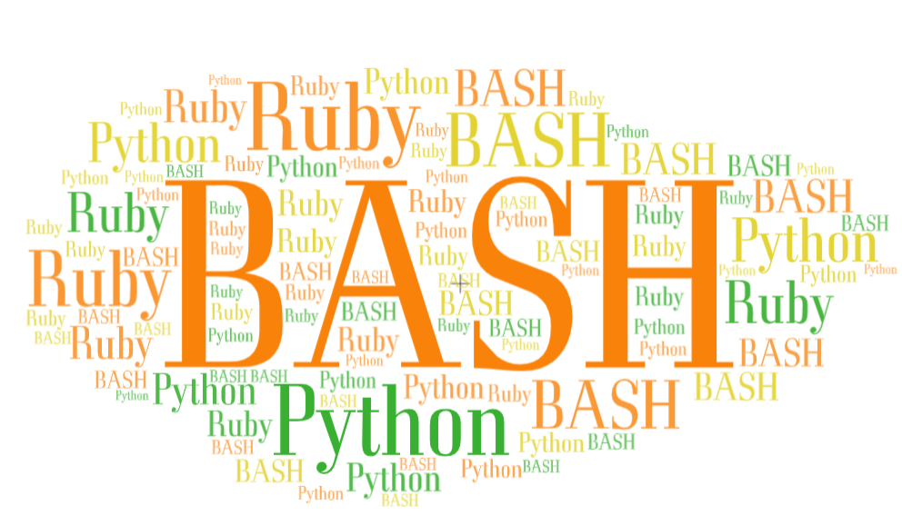

SCRIPTING LANGUAGES

Slide 2
A Programming language is a way by which programmers communicate with computers through the set of instructions known as code/program – which requires Compilation Step.
Popular programming languages are C++, C, Pascal, COBOL, Java
A Scripting language is a type of programming language which does not require explicit compilation step, and it is designed for a runtime system to automate the execution of tasks.“
The scripting language refers to dynamic, high-level, general-purpose interpreted languages
Popular Scripting Languages are Bash, Python, Perl, NodeJS, Ruby on Rails, etc.
All scripting languages are programming languages

Slide 3
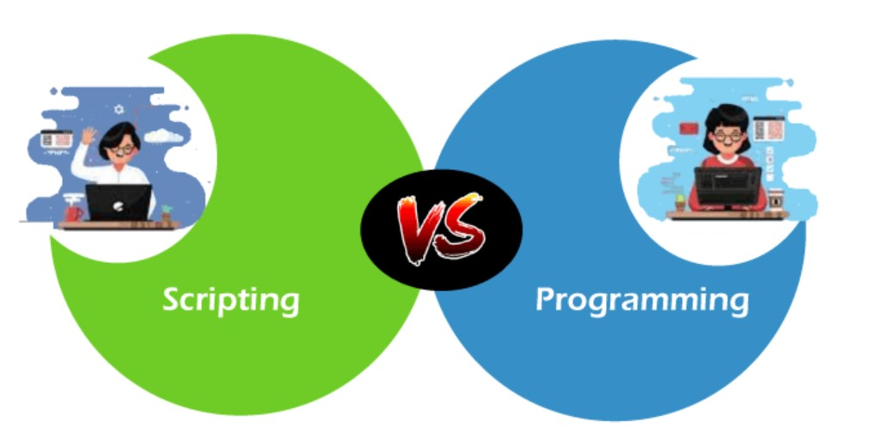
Scripts Vs Programs
All the Scripting languages are programming languages, but all programming languages are not scripting languages.
Scripting languages do not need an additional step of compilation and rather they are interpreted,
Whereas programming languages are compiled and hence need a compilation step to convert the high-level language to machine code.

Slide 4
What is meant by Script . . .??
It is small program written for a specific runtime environment.
These are interpreted at runtime rather than compiled.
It means, to convert the source code to machine code, scripting languages use an interpreter, not the compiler.
It brings new functions to applications and glue complex system together
A scripting language is a programming language designed for integrating and communicating with other programming languages.
Python a scripting language or programming language. . . . .?
Python uses an interpreter to translate and run its code

Slide 5
Why scripting languages are evolved?
In earlier days, programming languages were built to create software and applications such as Microsoft Excel, MS Word, Internet Explorer, etc.
But as time goes on, the demand to upgrade the programming languages has increased, and programs needed a way to add new functionalities, and hence scripting languages come into existence.
SLs are a specific kind of computer languages that you can use to give instructions to other software, such as a web browser, server, or standalone application

Slide 6
Origin of scripting
The use of the word ‘script’ in a computing context dates back to the early 1970s
The originators of the UNIX operating system create the term ‘shell script’ for 6 sequence of commands to read from a file.
Other early occurrences of the term ‘script’ can be found. For example, in a DOS based system, use of a dial-up connection to a remote system required a communication package that used proprietary language to write scripts to automate the sequence of operations required to establish a connection to a remote system.

Slide 7
Scripting today - Used With 3 Different Contexts
A new style of programming which allows applications to be developed much faster than traditional methods allow, and makes it possible for applications to evolve rapidly to meet changing user requirements.
This style of programming frequently uses a scripting language to interconnect ‘off the shelf ‘ components that are themselves written in conventional language.
Applications built in this way are called ‘glue applications’ ,and the language is called a ‘glue language’.

Slide 8
Use the scripting language to manipulate, customize and automate the facilities of an existing system’,
Here the script is used to control an application that provides a programmable interface (it is may be an API)
Example: use of Visual Basic for applications to control the applications in the Microsoft Office Suite.

Slide 9
Using a scripting language with its rich functionality and ease of use as an alternate to a conventional language for general programming tasks ,particularly system programming and administration.
Examples: are UNIX system administrators have for a long time used scripting languages for system maintenance tasks, and administrators of WINDOWS NT systems are adopting a scripting language ,PERL for their work

Slide 10
Application of Scripting Languages
Scripting languages are used in Web Applications. It is used in server side as well as client side. Server side scripting languages are: JavaScript, PHP, Perl etc. and client side scripting languages are: JavaScript, AJAX, jQuery etc.
Scripting languages are used in System Administration. For example: Shell, Perl, Python scripts etc.
It is used in Games Application and Multimedia.
It is used to create Plugins and Extensions for existing applications.
There are also scripting languages for operating systems, statistical analysis software, office applications, game engines, and many other kinds of platforms

Slide 11
Characteristics of scripting languages
Integrated compile and run
.They operate on an immediate execution, without need to issue separate command to compile the program and then to run the resulting object file, and without the need to link extensive libraries into he object code, this is done automatically
Low overheads and ease of use
variables can be declared by use
the number of different data types is usually limited
everything is string by context it will be converted as number(vice versa)
number of data structures is limited(arrays)

Slide 12
Enhanced functionality
SL’s usually have enhanced functionality in some areas.
For example, most languages provide string manipulation based on the use of regular expressions, while other languages provide easy access to low-level operating system facilities, or to the API, or object exported by an application
Efficiency is not an issue
ease of use is achieved at the expense of efficiency, because efficiency is not an issue in the applications for which SL’S are designed.

Slide 13
A scripting language is usually interpreted from source code or bytecode. By contrast, the software environment the scripts are written for is typically written in a compiled language and distributed in machine code form.
Scripting languages may be designed for use by
end users of a program
end-user development or
may be only for internal use by developers, so they can write portions of the program in the scripting language.

Slide 14
Scripting languages typically use abstraction, a form of information hiding, to separate users the details of internal variable types, data storage, and memory management.
Scripts are often created or modified by the person executing them, but they are also often distributed.
The characteristics of ease of use, particularly the lack of an explicit compile-link-load sequence, are sometimes taken as the sole definition of a scripting language.

Slide 15
Uses for Scripting Languages
classified into three types
Modern applications
Traditional uses
Web scripting

Slide 16
Modern applications of scripting languages are:
1.Visual scripting:
A collection of visual objects is used to construct a graphical interface.
This process of constructing a graphical interface is known as visual scripting.
The properties of visual objects include text on button, background and foreground colors.
These properties of objects can be changed by writing program in a suitable language. The outstanding visual scripting system is visual basic.
Visual scripting is also used to create enhanced web pages.

Slide 17
2.Scripting components
In scripting languages we use the idea to control the scriptable objects belonging to scripting architecture.
Microsoft's visual basic and excel are the first applications that used the concept of scriptable objects.
To support all the applications of Microsoft the concept of scriptable objects was developed.

Slide 18
3. Web scripting
web scripting is classified into three forms.
processing Forms,
Generating Dynamic Web pages,
dynamically generating interacting with Database.
Applications of traditional scripting languages are:
system administration,
experimental programming,
controlling applications

